Slide 1
Ad_HOC Insights
Consumer Goods

Slide 2
WHAT
COMPANY’S DETAIL MARKET
WHY
OBJECTIVE
HOW
Data,Request,Tools

Slide 3
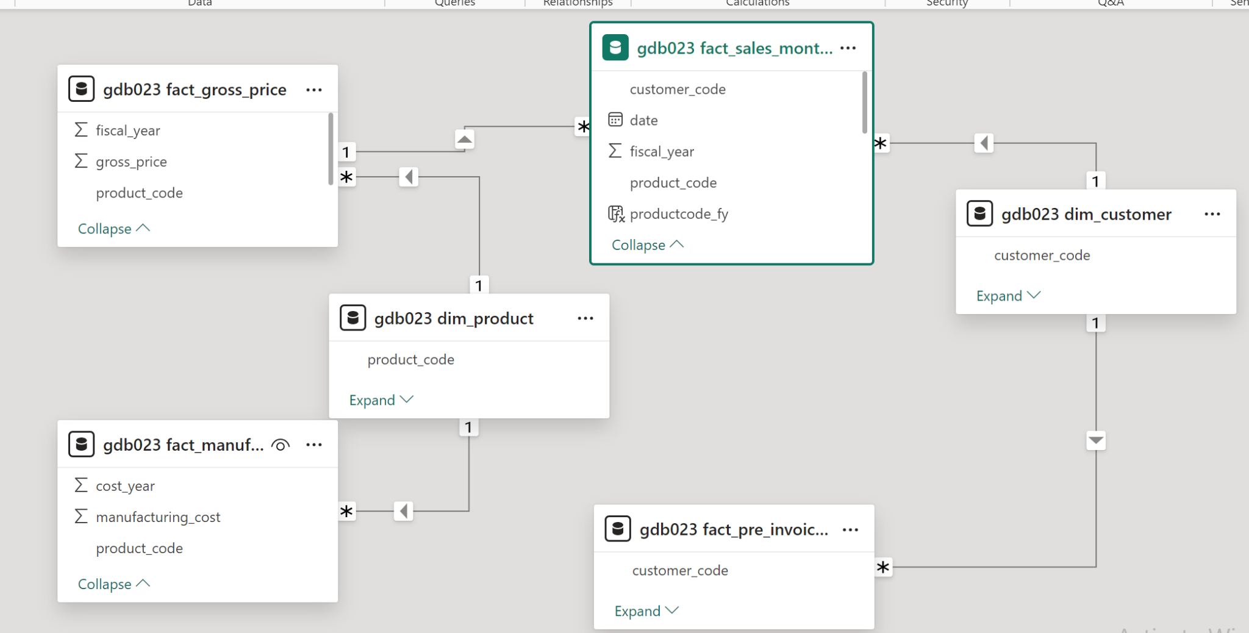

Slide 4
Atliq Hardwares is one of the leading computer hardware producers in India and well expanded in other countries too.
The management noticed that they do not get enough insights to make quick and smart data-informed decisions.
The company seeks insights for 10 ad hoc requests.
Fiscal year FY 20 and FY 21
Objective

Slide 5
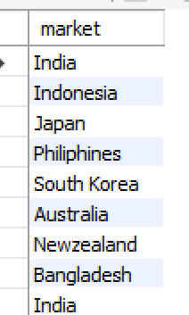
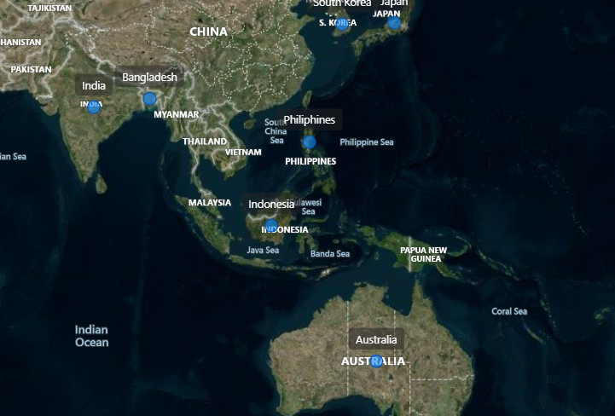
1. Provide the list of markets in which customer "Atliq Exclusive" operates its business in the APAC region

Slide 6

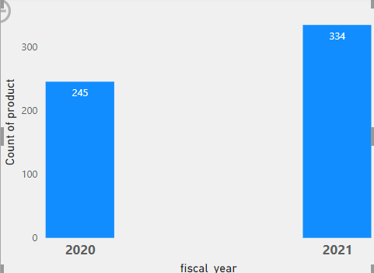
2. What is the percentage of unique product increase in 2021 vs. 2020? The final output contains these fields, unique_products_2020 unique_products_2021 percentage_chg
Insights : It's a good sign that we are continuously inventing new product

Slide 7
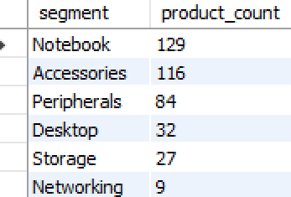
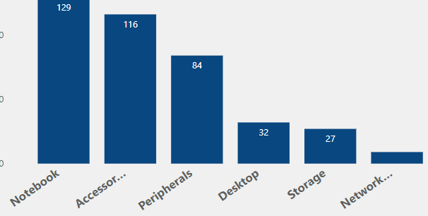
3. Provide a report with all the unique product counts for each segment and
sort them in descending order of product counts. The final output contains
2 fields,
segment,product_count
Segment Notebook ,Accessories have shown significant manufacturing growth as compared to storage and Networking

Slide 8
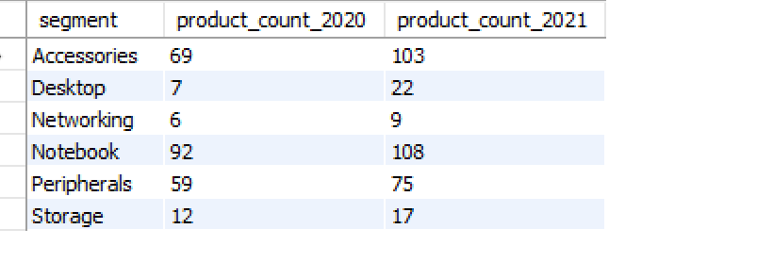
4. Which segment had the most increase in unique products in
2021 vs 2020? The final output contains these fields,segment product_count_2020 product_count_2021
Accessories had the most increase in unique products in
2021 vs 2020

Slide 9
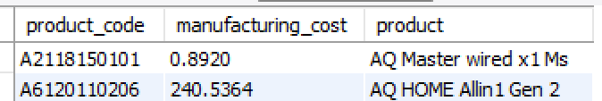
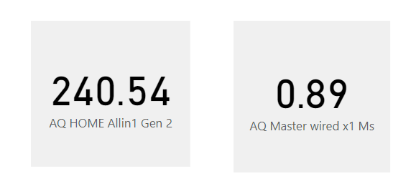
5. Get the products that have the highest and lowest manufacturing costs.
The final output should contain these fields,
product_code
product
manufacturing_cost
Master wired MS-Mouse has the lowest manufacturing cost.
Home Allin1 Gen2-personal desktop has the highest manufacturing cost.

Slide 10
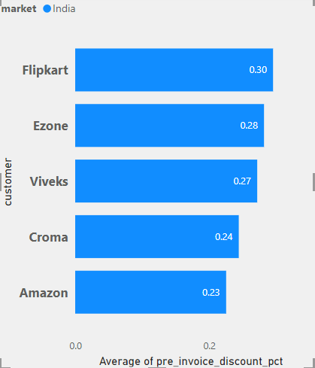
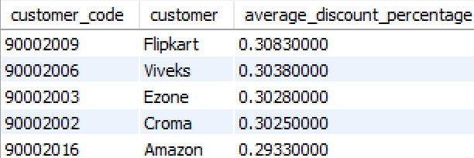
6. Generate a report which contains the top 5 customers who received an average high pre_invoice_discount_pct for the fiscal year 2021 and in the
Indian market. The final output contains these fields,
-- customer_code
-- customer
-- average_discount_percentage
Flipkart received highest pre_invoice_discount_pct Amazon received lowest pre_invoive_discount

Slide 11
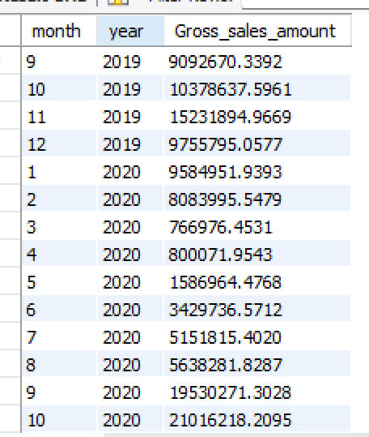
7. Get the complete report of the Gross sales amount for the customer “Atliq Exclusive” for each month. This analysis helps to get an idea of low and
high-performing months and take strategic decisions.
The final report contains these columns:
Month
Year
Gross sales Amount

Slide 12
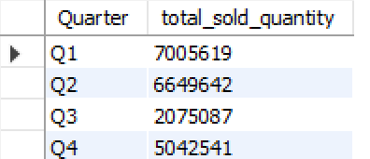
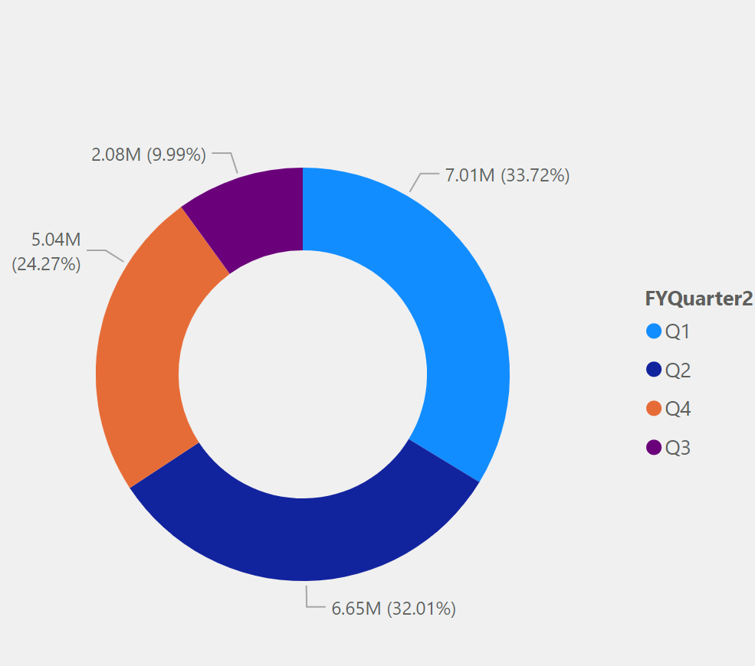
-- 8. In which quarter of 2020, got the maximum total_sold_quantity? The final
output contains these fields sorted by the total_sold_quantity,
Quarter
total_sold_quantity

Slide 13
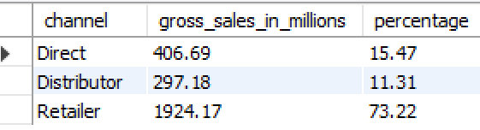
9.Which channel helped to bring more gross sales in the fiscal year 2021
and the percentage of contribution? The final output contains these fields,
-- channel
-- gross_sales_mln
-- percentage
Retail channel helped to bring highest gross sales in year 2021 round 73.22%

Slide 14
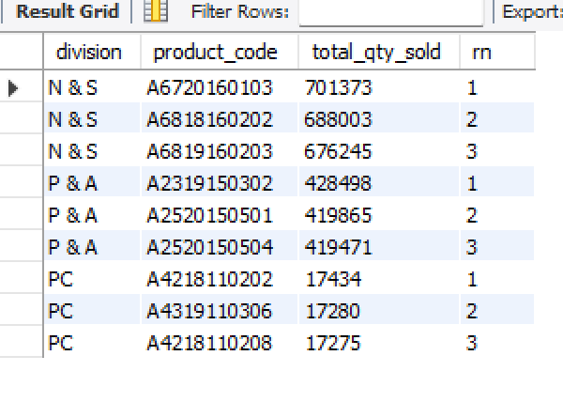
10. Get the Top 3 products in each division that have a high
total_sold_quantity in the fiscal_year 2021? The final output contains these
fields,
division
product_code
product
total_sold_quantity
rank_order

Slide 15
